Slide 1

CROP PRODUCTION ANALYSIS IN INDIA
Internship Project By Pooja Upadhye with UNIFIED MENTOR

Slide 2
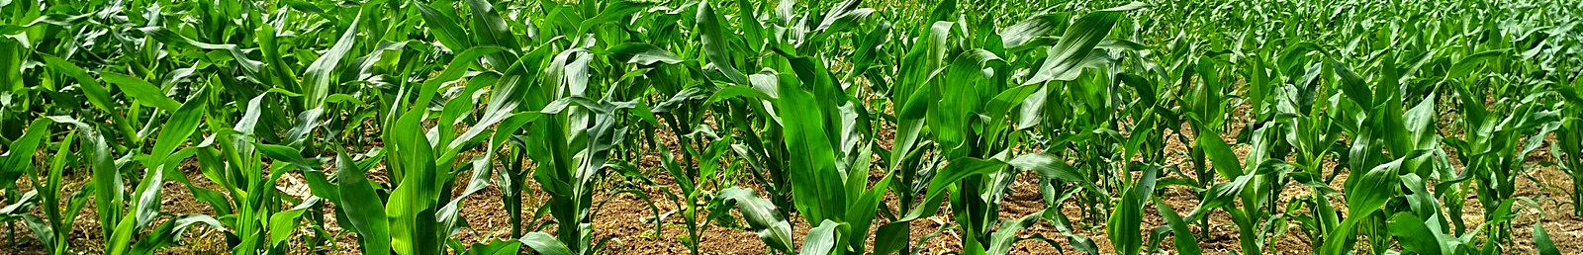
CHALLANGE OVERVIEW
The Agriculture business domain, as a vital part of the overall supply chain, is
expected to highly evolve in the upcoming years via the developments, which are
taking place on the side of the Future Internet. This presentation presents a novel
Business-to-Business collaboration platform from the agri-food sector perspective,
which aims to facilitate the collaboration of numerous stakeholders belonging to
associated business domains, in an effective and flexible manner.

Slide 3

INTRODUCTION OF DATASET
This dataset provides a huge amount of information on crop production in India ranging from several years. Based on the Information the ultimate goal would be to predict crop production and find important insights highlighting key indicators and metrics that influence crop production.

Slide 4

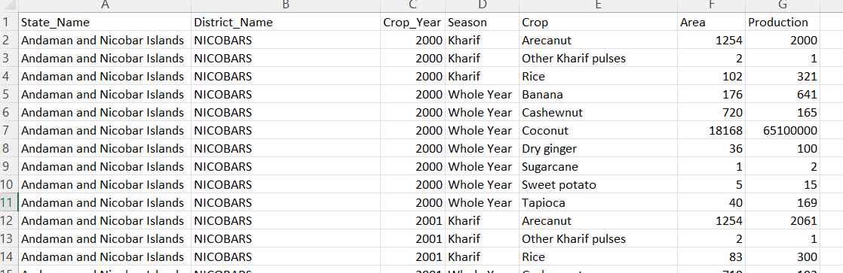
OVERVIEW OF DATASET

Slide 5

Season based crops
Total Production
Total Area
Year wise Production
Area Wise Production
MAIN KPI’S

Slide 6

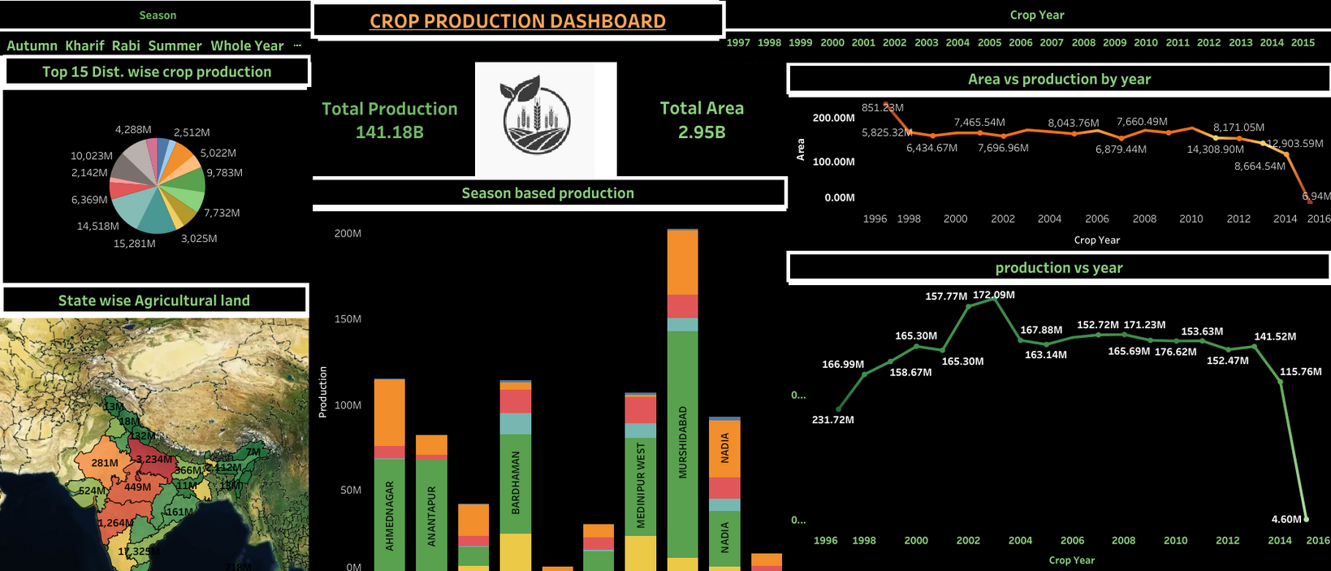
OVERVIEW OF DASHBOARD

Slide 7

CONCLUSION
CROP VARIETY SELECTION : The project highlighted the importance of selecting suitable crop varieties that are well adapted to local conditions.
PRODUCTION TRENDS: Identified pattern in crop production Analysis by season based production, state wise production, yearly production, top district wise crop production.

Slide 8
THANK YOU

